Slide 1
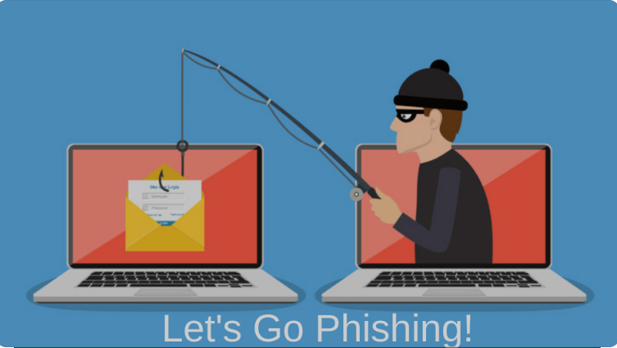
Unit-04 Phishing and Identity Theft
Dept. of CSE(CS), MSRIT

Slide 2
Phishing
A type of e-mail scam that steals your identity.
An e-mail fraud technique in which the culprit sends out e-mails looking legitimate in an effort to accumulate personal and financial information from recipients (messages likely come from well-known and trustworthy sites, viz., PayPal, eBay, MSN, Yahoo, BestBuy, and America Online).
Phishers use different social engineering and e-mail spoofings to try to trick their victims.
The act of sending an e-mail to a user and falsely claiming to be an established legitimate organization to scam the user into giving up private information to be used for identity theft.
The e-mail steers the user to visit a Web site where they are asked to update their personal information, viz., their passwords and information about their credit cards, bank account numbers, etc.
Dept. of CSE(CS), MSRIT

Slide 3
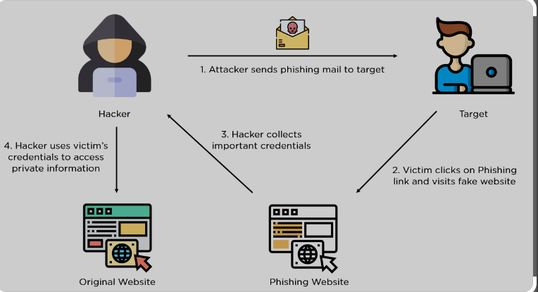
Phishing
Dept. of CSE(CS), MSRIT

Slide 4
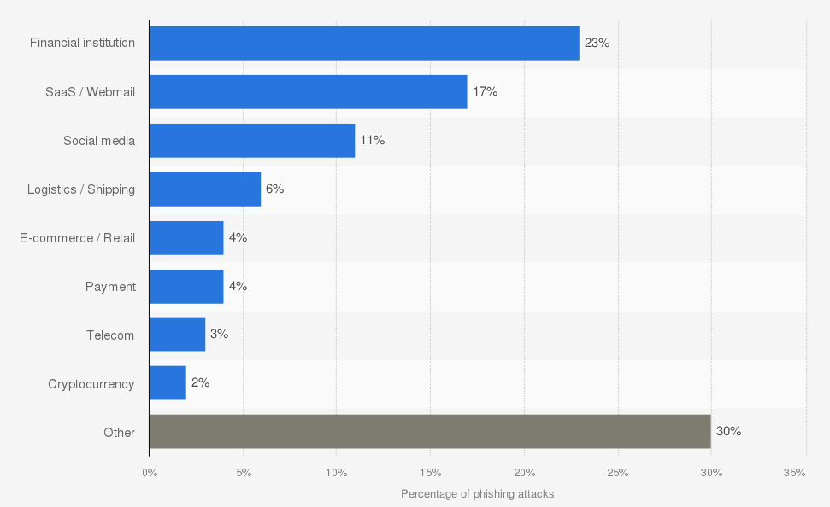
Phishing
Dept. of CSE(CS), MSRIT

Slide 5
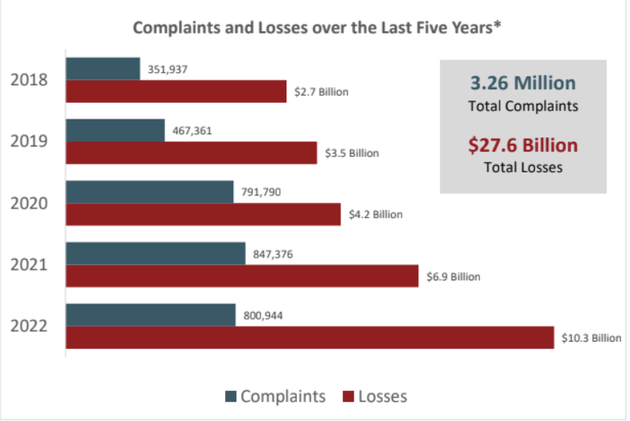
Phishing
Dept. of CSE(CS), MSRIT

Slide 6
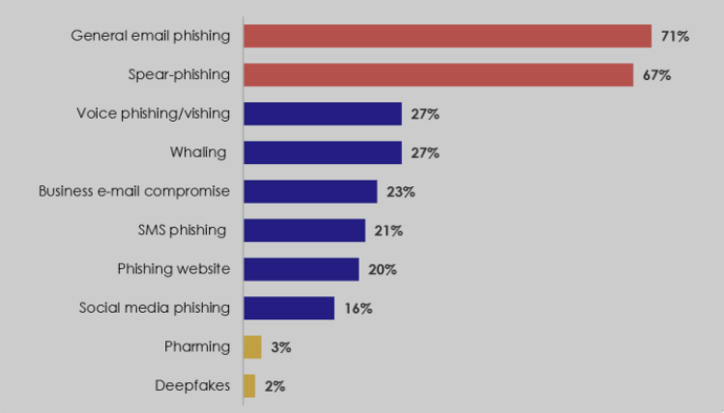
Phishing
Dept. of CSE(CS), MSRIT

Slide 7
SPAM Emails
Spam E-Mails
Also known as “junk E-Mails”
Identical messages are sent to numerous recipients
Popular medium for phishers to scam users to enter personal information on fake websites
A person who creates electronic spam is called a spammer
Botnets are used to send about 80% of spam. SPAMBOTS (web crawlers) are used to send SPAM emails.
Types
Unsolicited bulk E-Mail (UBE)
Unsolicited Commercial E-Mail (UCE)
Dept. of CSE(CS), MSRIT

Slide 8
Phishing
Tactics used by a phisher
Names of legitimate organizations:-
“From” a real employee
URLs that “look right”
Urgent messages
Dept. of CSE(CS), MSRIT

Slide 9
Phishing
Phrases used to entice the user to take action
“Verify your account”
“You have won the lottery”
“If you don’t respond within 48 hours, your account will be closed”
Dept. of CSE(CS), MSRIT

Slide 10
Common features of Phishing Emails
Too Good To Be True
Sense of Urgency
Hyperlinks
Attachments
Unusual Sender
Dept. of CSE(CS), MSRIT

Slide 11
Phishing
Hoax E-Mails
Deliberate attempt to deceive or trick a user into believing or accepting that something is real.
Hoax E-Mails may or may not be Spam E-Mails.
www.breakthechain.org, www.hoaxbusters.org
Dept. of CSE(CS), MSRIT

Slide 12
Website Spoofing, XSS and XSRF
Website Spoofing:
Act of creating a website as a hoax.
The website will adopt the design of the target website.
XSS(Cross Site Scripting)
Enable malicious attackers to inject client-side scripts into webpages.
XSRF(Cross-site Request Forgery)or CSRF
Dept. of CSE(CS), MSRIT

Slide 13
Phishing
Methods of Phishing
Dragnet( Involves the use of spammed E-Mails bearing falsified corporate identification.)
2. Rod-and-reel (identifying specific prospective victims in advance and convey false information to them to prompt their disclosure of personal and financial data)
3. Lobsterpot (focuses upon the use of spoofed websites)
4. Gillnet (relies far less on social engineering techniques and phishers introduce Malicious Code into E-Mails and websites)
Dept. of CSE(CS), MSRIT

Slide 14
Phishing Techniques
Phishing Techniques
URL (weblink) manipulation
Filter evasion
Website forgery
Flash Phishing
Social Phishing
Phone Phishing
Phishers usually send millions of E-Mail messages, pop-up windows, etc., that appear to be looking official and legitimate.
Dept. of CSE(CS), MSRIT

Slide 15
Spear Phishing
Spear Phishing
A method of sending a Phishing message to a particular organization to gain organizational information for more targeted social engineering.
Spear phishers send E-Mail that appears genuine
The message might look like as if it has come from your employer, or from a colleague who might send an E-Mail message to everyone in the company (such as the person who manages the computer systems); it could include requests for usernames or passwords.
Dept. of CSE(CS), MSRIT

Slide 16
Whaling
A specific form of “Phishing” and/or “Spear Phishing” – targeting executives from the top management in the organizations, usually from private companies.
The objective is to swindle the executives into revealing confidential information.
Whaling targets C-level executives sometimes with the help of information gleaned through Spear Phishing, aimed at installing malware for keylogging or other backdoor access mechanisms.
E-Mails sent in the whaling scams are designed to masquerade as a critical business E-Mail sent from a legitimate business body and/or business authority.
Whaling phishers have also forged official-looking FBI subpoena E-Mails and claimed that the manager needs to click a link and install special software to view the subpoena.
Dept. of CSE(CS), MSRIT

Slide 17
Types of Phishing Scams
Types of Phishing Scams
Deceptive Phishing
Malware-based Phishing
Keyloggers
Session hijacking
In-session Phishing
6. Web Trojans
7. Pharming
8. System reconfiguration attacks
9. Data theft
10. Content-injection Phishing
11. Man-in-the-middle Phishing
12. Search engine Phishing
13. SSL certificate Phishing
Dept. of CSE(CS), MSRIT

Slide 18
Types of Phishing Scams
Distributed Phishing Attack (DPA)
An advanced form of phishing attack that works as per victim’s personalization of the location of sites collecting credentials and a covert transmission of credentials to a hidden coordination center run by the phisher.
A large number of fraudulent web hosts are used for each set of lured E-Mails.
Each server collects only a tiny percentage of the victim’s personal information.
Phishing Toolkits and Spy Phishing
A Phishing toolkit is a set of scripts/programs
Quite expensive
Phishers use hypertext preprocessor (PHP) to develop the Phishing kits.
Most of the Phishing kits are advertised and distributed at no charge and usually these are free Phishing kits – also called DIY (Do It Yourself ) Phishing kits.
Dept. of CSE(CS), MSRIT

Slide 19
Phishing Countermeasures
It is always challenging to recognise/judge the legitimacy of a website while Googling.
Do not click on hyperlinks
Keep antivirus up to date.
Take advantage of antivirus spam.
Verify HTTPS
Use antispyware software
Don’t click unknown hyperlinks in emails
Turn on firewall
Use Microsoft Baseline Security Analyzer(MBSA) to detect various vulnerabilities in windows operating system.
Dept. of CSE(CS), MSRIT

Slide 20
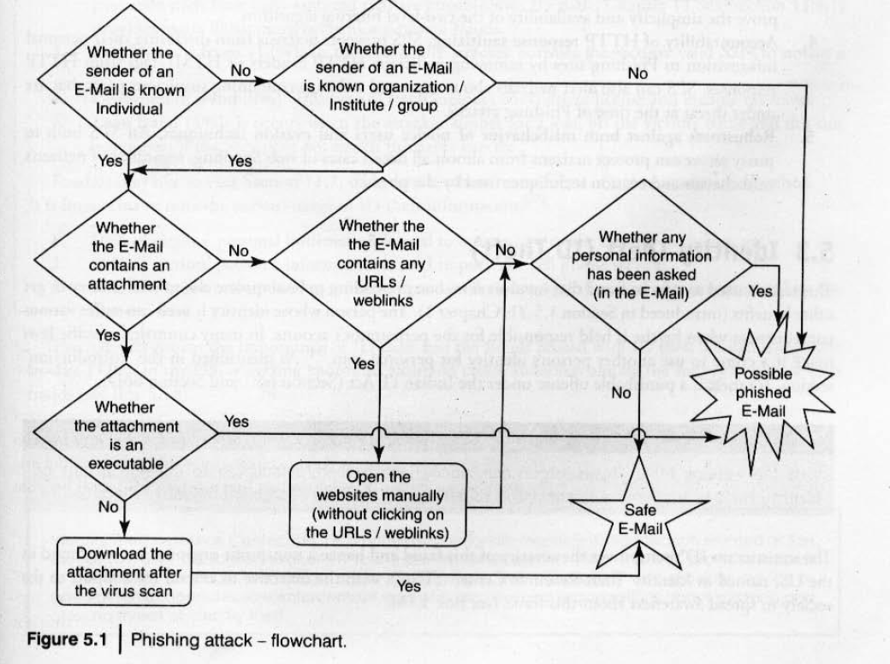
Phishing Attack
Dept. of CSE(CS), MSRIT

Slide 21
Phishing Countermeasures
SPS Algorithm to Thwart Phishing Attacks
With the Sanitizing Proxy System (SPS), web Phishing attacks can be immunized by removing part of the content that entices the users into entering their personal information.
SPS sanitizes all HTTP responses from suspicious URLs with warning messages.
Dept. of CSE(CS), MSRIT

Slide 22
Characteristics of SPS
Two-Level Filtering: SPS employs URL filtering and HTTP response sanitizing
The flexibility of the rule set:- Distinguishes between legitimate websites and suspicious websites
Simplicity of the filtering algorithm: The filtering algorithm contains 20 steps, and can easily apply the existing SPS functions to existing proxy implementations, browser plugins or personal firewalls.
Accountability of HTTP response sanitizing: SPS prevents users from disclosing their personal information to phishing sites.
Robust against both misbehaviour of novice users and evasion techniques:
Dept. of CSE(CS), MSRIT

Slide 23
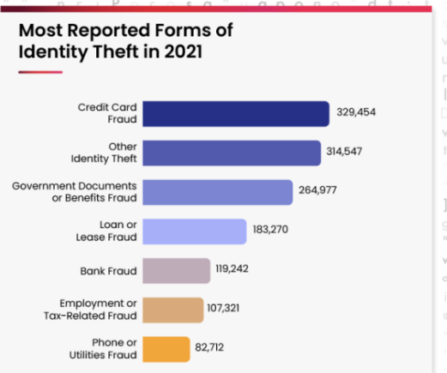
Identity Theft
Identity Theft (ID Theft)
Fraud that involves someone pretending to be someone else to steal money or get other benefits.
The person whose identity is used can suffer various consequences when he/she is held responsible for the perpetrator’s actions.
ID theft is punishable under the Indian IT Act(Section 66C and Section 66D)
Dept. of CSE(CS), MSRIT

Slide 24
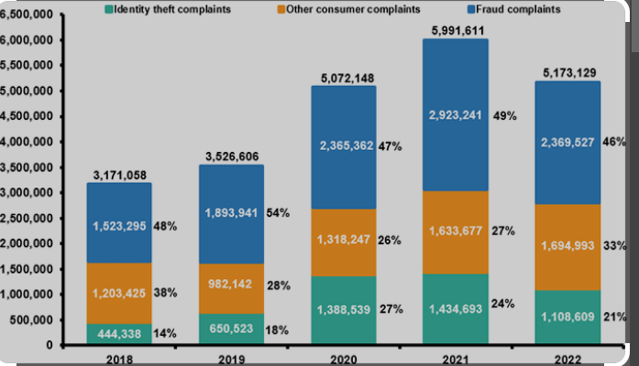
Identity Theft
Dept. of CSE(CS), MSRIT

Slide 25
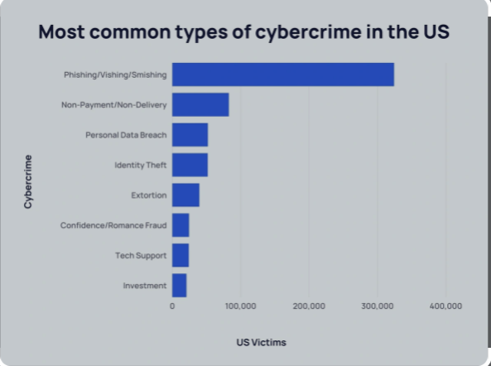
Identity Theft-Statistics
According to the Federal Bureau of Investigation’s (FBI) 2021 Internet Crime Report, the most common type of cybercrime in the US is phishing/vishing/smishing - all of which involve stealing users’ personal data.
These types of cyber crimes occur almost 4x more than any other.
Around $4 billion is lost to cybercrime each year in the US alone (FBI)
Cybercrime can be incredibly costly for victims.
Dept. of CSE(CS), MSRIT

Slide 26
Personally Identifiable Information(PII)
Fraudsters attempt to steal the elements mentioned below:
1. Full name
2. National identification number (e.g., SSN)
3. Telephone and mobile phone numbers
4. Driver’s license number
5. Credit card numbers
6. Digital identity (e.g., E-Mail address, online account ID and password)
7. Birth date and Place name
8. Face and fingerprints
Dept. of CSE(CS), MSRIT

Slide 27
Identity Theft
A fraudster generally searches the following about an individual:
1. First or last name
2. age
3. country, state or city of residence
4. gender
5. name of the school/college/workplace
6. job position, grades and/or salary
7. criminal record
Dept. of CSE(CS), MSRIT

Slide 28
Identity Theft
Types of Identity Theft
1. Financial identity theft
2. criminal identity theft—Cyber crimes, organized crimes, drug trafficking etc
3. identity cloning
4. business identity theft
5. medical identity theft
6. synthetic identity theft
7. child identity theft
Dept. of CSE(CS), MSRIT

Slide 29
Techniques of Identity Theft
Human-based methods
a. Direct Access to information
b. Dumpster Diving
c. Mail Theft and Rerouting
d. Shoulder Surfing
e. Falsed or Disguised ATMs
f. Dishonest or mistreated employees
h.Telemarketing or fake calls
2. Computer-based technique
a. Backup Theft
b. Hacking, Unauthorized Access
c. Phishing
d. Pharming
Dept. of CSE(CS), MSRIT

Slide 30
Identity Theft Countermeasures
Monitor your credit closely
Keep records of your financial data and transactions
Install security software
Use an updated web browser
Beware of Email attachments and links
Protect your PII
Store sensitive data securely
Dept. of CSE(CS), MSRIT

Slide 31
How to protect/Efface your online Identity
www.giantmatrix.com--- Anti Tracks
www.privacyeraser.com--- PrivacyeraserPro
www.reputationdefender.com ---MyPrivacy
www.suicidemachine.org Web2.0 Suicide machine
www.seppukoo.com –seppukoo
Dept. of CSE(CS), MSRIT

